Slide 1
CMPUT 206: Image Segmentation I
Nilanjan Ray
Computing Science
University of Alberta

Slide 2
Agenda
One of the most difficult and widely used application in image analysis is segmentation
What is image segmentation?
Classical methods (this lecture)
More advanced methods (next lecture)

Slide 3
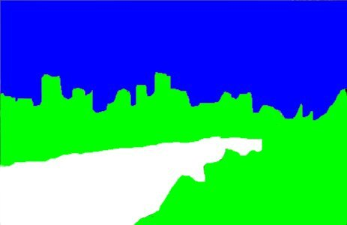

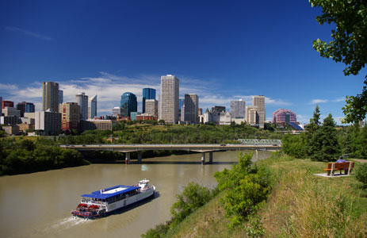
What is image segmentation?
Edmonton (Picture source: westjet.com)

Slide 4
Classical Segmentation Methods
Automatic threshold operation
Applies to grayscale image
Produces a binary image as the result of segmentation
Clustering
Applies to both color and grayscale images
Can produce two or more pixel labels
Region merging
Watershed (very old method) + merging of watershed regions
Statistical region merging (more recent): http://fiji.sc/wiki/index.php/Statistical_Region_Merging

Slide 5
Automatic Threshold Method
Otsu’s Method
For every threshold value, compute intra-class variance
Pick the threshold value that results in the lowest intra-class variance
Example computation of intra-class variance:
3 | 4 | 8 | 2
6 | 9 | 3 | 7
4 | 1 | 9 | 3
For a threshold value = 6, we have two classes for the
example image
C1={3, 4, 2, 3, 4, 1, 3} and C2 = {8, 6, 9, 7, 9}
v1 = variance of pixel values in C1 = 0.9796
v2 = variance of pixel values in C2 = 1.36
Intra-class variance = (7/12)*0.9796 + (5/12)*1.36 = 1.1381
Example image

Slide 6
ImageJ: Otsu’s Automatic Threshold
Result of Otsu’s
applying threshold
Grayscale image

Slide 7
Image Segmentation With Region Merging
Basic strategy:
Compute small regions
Example method: Watershed method
Merge neighboring regions having similar properties (such as: mean color values, texture, etc.)
Example method: Statistical region merging

Slide 8
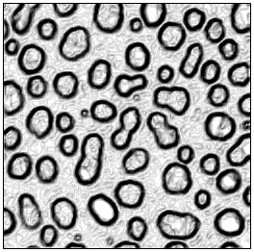
ImageJ: Watershed Regions
Grayscale image
Edge strength
(darker pixels imply
stronger edges)
Watershed regions

Slide 9
Statistical Region Merging
Step 1: Consider all neighboring pixel pairs
Step 2: Sort the pairs according to color difference in increasing order
Step 3: Merge pairs according to a threshold value

Slide 10
Color image segmentation
Let’s watch a short video: https://www.youtube.com/watch?v=aqt2PPZqldk

Slide 11
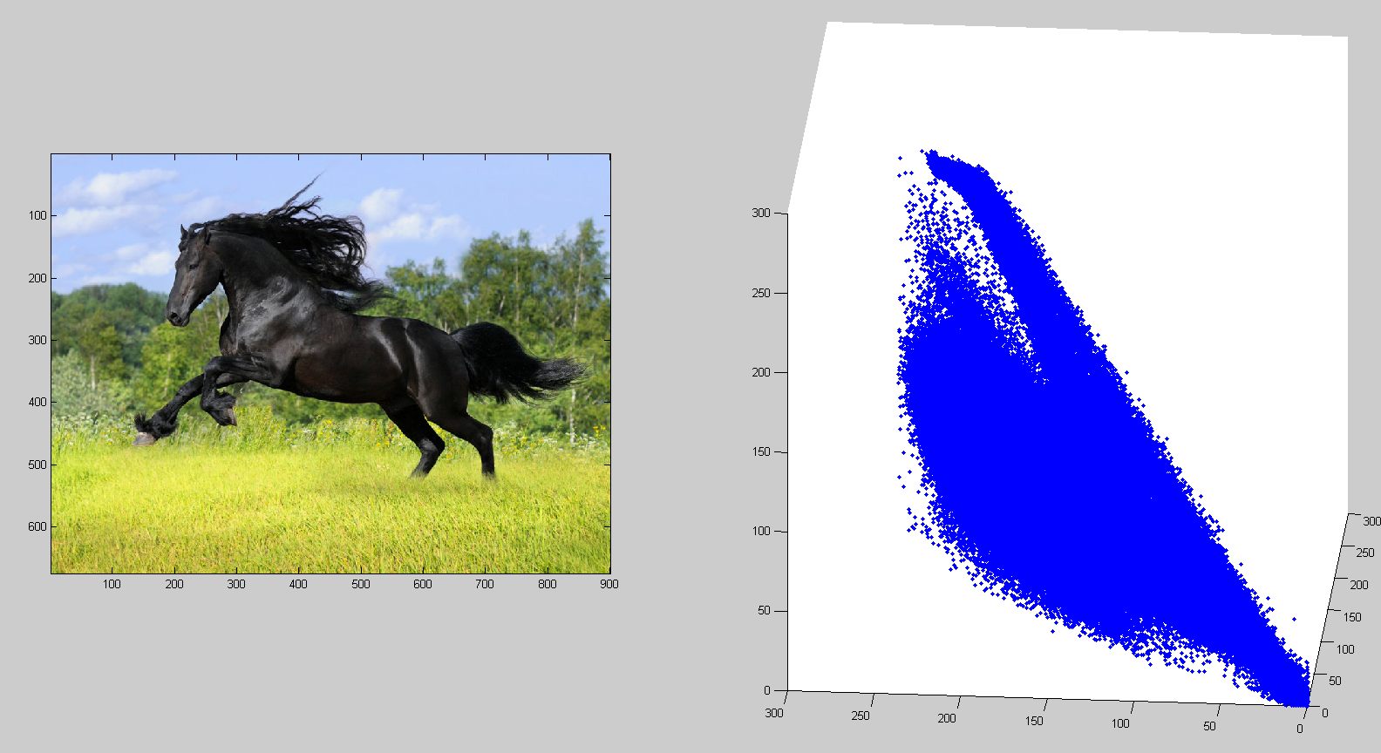
Color image segmentation by clustering

Slide 12
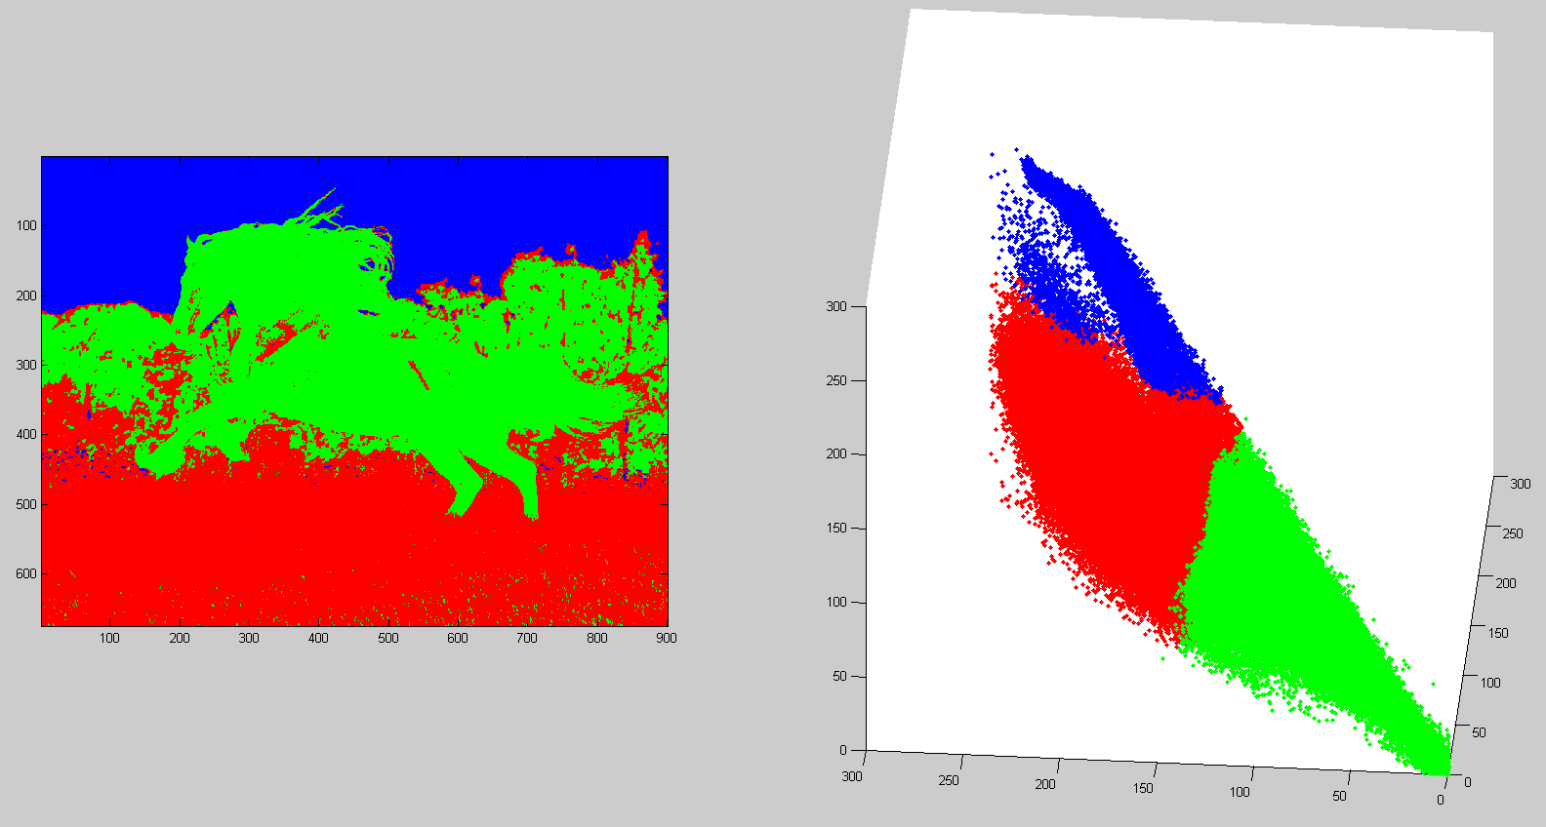
Color image segmentation by clustering…

Slide 13
Segmentation with user interaction
User has labeled three regions.
For each pixel location, find the closest (in R-G-B space) pixel user has labeled.
This can be done efficiently by building a kd-tree and performing an approximate
nearest neighbor search.

